Slide 1
CSE 480 Web Technology

Slide 2
Learning Goals
Describe how Web servers and clients interact with each other.
Request resources from web servers and understand the responses.
Describe the different URL components
Explain the difference between HTTP and HTTPS.

Slide 3
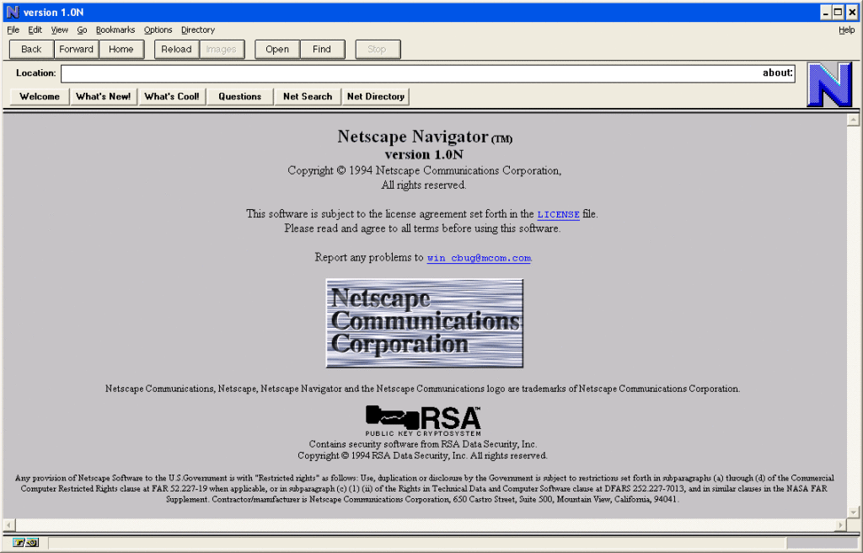
The Web: a brief history
World Wide Web: a global system of interconnected hypertext documents available via the Internet (envisioned already in 1945)
1960s: Precursor to the Internet (ARPANET) devised by the US department of Defense → Initial services: electronic mail, file transfer
Late 1980s: Internet opened to commercial interests
1989: WWW created by Tim Berners-Lee
(CERN)
1994: Netscape released its first Web browser
1995: Microsoft released Internet Explorer
v1
1998: Google was founded
2002: Mozilla released Firefox v1

Slide 4
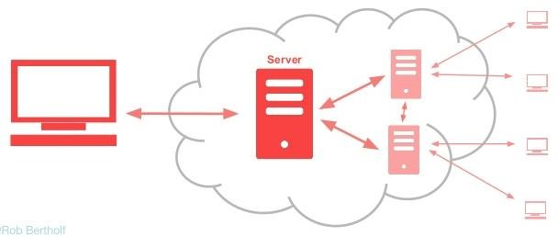
Key aspects of the Internet
Internet: interconnected computer networks that span the globe; communicating through a common standard (TCP/IP)
Sub-networks function autonomously
No centralised control
Devices dynamically join/leave the network
Devices interact through open standards
Easy to use: server/client software widely available
Two important organisations
Internet Engineering Task Force (IETF) - “The mission of the IETF is to make the Internet work better by producing high quality, relevant technical documents that influence the way people design, use, and manage the Internet.”
World Wide Web Consortium (W3C) - “The W3C mission is to lead the World Wide Web to its full potential by developing protocols and guidelines that ensure the long-term growth of the Web.”

Slide 5
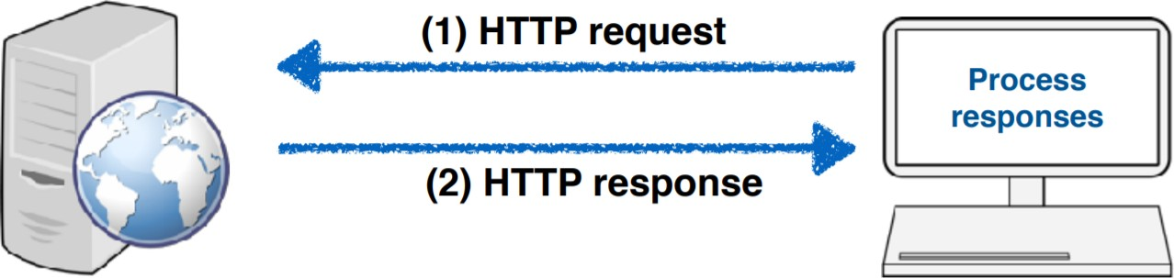
Web servers and clients
Servers wait for data requests
Answer thousands of clients simultaneously
Host web resources (content with an identity)
Clients are often browsers
Application:
Display, execute, music player, Acrobat Reader

Slide 6
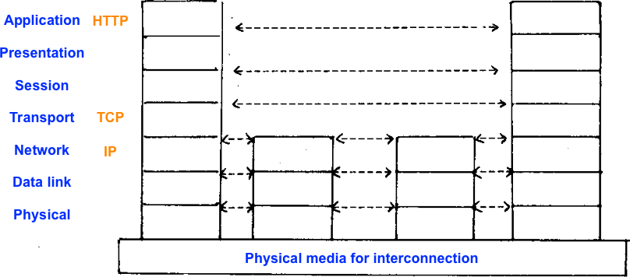
Network communication
Image sourced from the OSI reference model paper

Slide 7
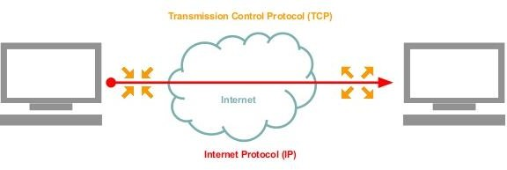
What is a Protocol?
Set of rules that allow two electronic items to connect to and exchange information with one another.

Slide 8
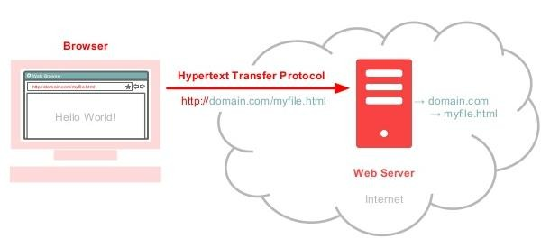
HTTP Protocol
Set of rules that allow two electronic items to connect to and exchange information with one another.

Slide 9
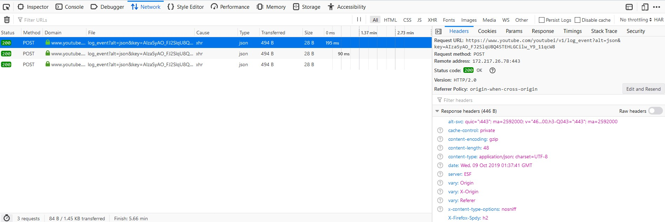
HTTP Protocol
Set of rules that allow two electronic items to connect to and exchange information with one another.

Slide 10
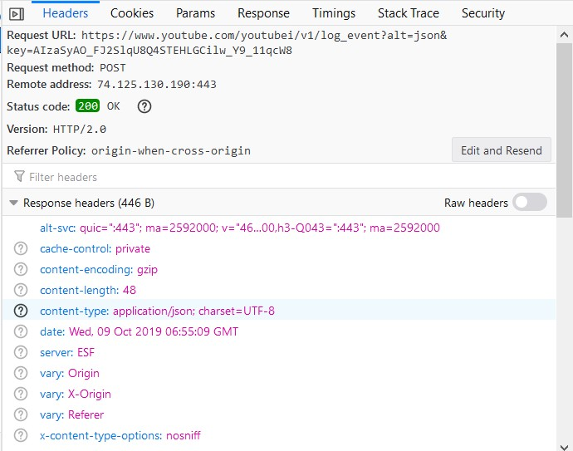
HTTP Protocol
HTTP request message
HTTP is a plain text protocol and line-oriented. The first line indicates what this message is about. In this case the keyword POST indicates that we are sending something.
HTTP response message
The status code indicates the status of the response. In this case, the server sends back the status 200 OK: everything is okay, the resource was found, you are allowed to receive it.
Status codes
1xx | Informational
2xx | Success
3xx | Redirected
4xx | Client error
5xx | Server error

Slide 11
HTTP Protocol
Well-known header fields
Header field | Description
Content-Type | Entity type
Content-Length | Length/size of the message
Content- Language | Language of the entity sent
Content-Encoding | Data transformations applied to the entity
Content-MD5 | Checksum of the content
Last-Modified | Date at which the entity will become stale
Connection & Upgrade | Protocol upgrade

Slide 12
HTTP Protocol
Most popular | Least popular
Text/html | application/pgp-keys
image/jpg | application/x-httpd-php4
text/xml | chemical/x-pdb
application/rss+xml | model/mesh
text/plain | application/x-perl
application/xml | audio/x_mpegurl
text/calendar | application/bib
application/pdf | application/postscript
application/atom+xml | application/x-msdos-program
Content-Type
MIME stands for Multipurpose Internet Mail Extensions and was designed to solve problems when moving messages between electronic mail systems; it worked well and was adopted by HTTP to label its content.

Slide 13
HTTP Protocol
How do client and server negotiate acceptable encodings?
Content-Encoding
Content is often encoded, and in particular compressed. The four common encodings are:
(a) gzip (b) compress (c) deflate (d)identity (this encoding indicates that no encoding should be used)
If the server would send content in an encoding for which the client requires specific software to decode but does not have, the client receives a blob of data but is unable to interpret it. To avoid this situation, the client sends in the HTTP request a list of encodings it can deal with. This happens in the
But why bother with encodings at all?
If an image or video is compressed by the server before it is sent to the client, network bandwidth is saved. There is a tradeoff, however: compressed content needs to be decompressed by the client, which increases the processing costs.

Slide 14
HTTP Protocol
Common HTTP methods
Methods
GET | Request to get access to some web resource
HEAD | Returns the header of a HTTP response only (not the content)
POST | Sends data from the client to the server for processing
PUT | Saves the body of the request on the server; if you have ever used ftp you are already familiar with put
TRACE | Can be use to trace where a message passes through before arriving at the server
OPTIONS | Is helpful to determine what kind of methods a server supports
DELETE | Can be used to remove documents from a web server

Slide 15
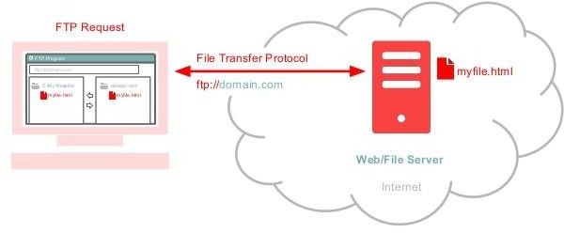
File Transfer Protocol (FTP)
Set of rules that allow two electronic items to connect to and exchange information with one another.

Slide 16
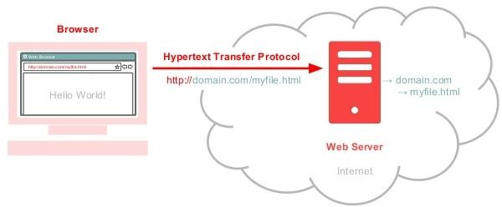
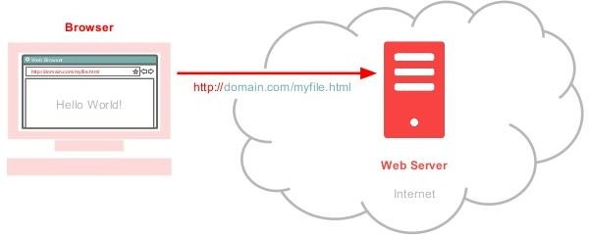
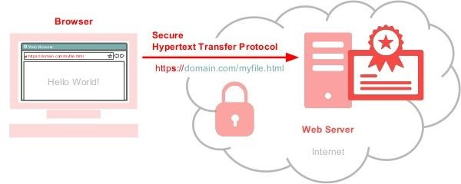
Accessing the World Wide Web
s

Slide 17
Protocol Recap
We use Hypertext Transfer Protocol (http://) to access websites.
We use File Transfer Protocol (ftp://) to store and retrieve files from the internet.
SSL Certificates secure the HTTP protocol (https://) to guard data passed through.

Slide 18
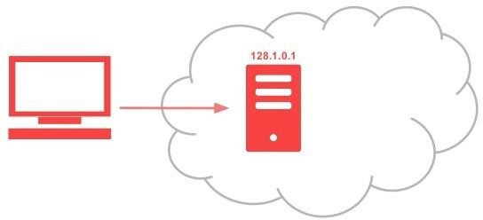
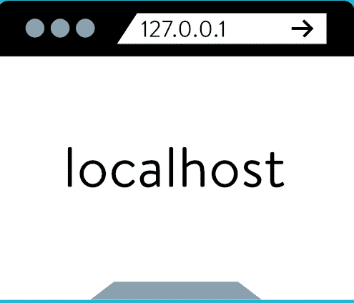
How to find a web server?
Internet Protocol (IP) address - a unique string of numbers separated by periods that identifies each computer using the Internet Protocol to communicate over a network.
Internet locations have IP addresses – 128.1.0.1
IP address – localhost – 127.0.0.1
The IP address 127.0.0.1 is the loopback Internet
protocol (IP) address also referred to as the “localhost”
If you wanted to use your web browser to access your local web server this would be the IP address used to establish an IP connection to the same machine or computer being used by the end-user.

Slide 19
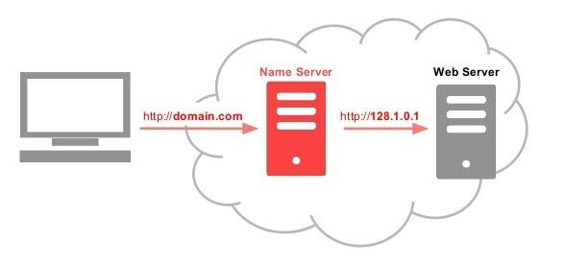
How to a Domain Name?
Domain Name – A domain name is an identification string that defines a realm of administrative autonomy, authority or control within the Internet.
Top level domain extensions
.com = Commercial
.org = Organization
.net =Network
.gov = Government
.edu = Education
Domain Name System (DNS) – a system for naming computers and network services that is organized into a hierarchy of domains. DNS naming is used in TCP/IP networks, such as the Internet, to locate computers and services through user-friendly names.

Slide 20
Uniform Resource Locators (URLs)
Let's now take a closer look at the format of Uniform Resource Locators, more commonly known by their abbreviation URLs.
URLs are the common way to access any resource on the Internet; the format of URLs is standardized. You should already be relatively familiar with the format of URLs accessing resources through HTTP and HTTPS. Resource access in other protocols (e.g. ftp) is similar, with only small variations.
In general, a URL consists of up to 9 parts:
<scheme>://<user>:<password>@<host>:<port>/<path>;<params>?<query>#<frag>

Slide 21
Uniform Resource Locators (URLs)
<scheme>://<user>:<password>@<host>:<port>/<path>;<params>?<query>#<frag>
From back to front
Methods
<frag> | The name of a piece of a resource. Only used by the client - the fragment is not transmitted to the server.
<query> | Parameters passed to gateway resources, i.e. applications [identified by the path] such as search engines.
<params> | Additional input parameters applications may require to access a resource on the server correctly. Can be set per path segment.
<path> | the local path to the resource

Slide 22
Uniform Resource Locators (URLs)
<scheme>://<user>:<password>@<host>:<port>/<path>;<params>?<query>#<frag>
From back to front
Methods
<port> | the port on which the server is expecting requests for the resource (ports enable multiplexing: multiple services are available on one location)
<host> | domain name (host name) or numeric IP address of the server
<user>:<password> | the username/password (may be necessary to access a resource)
<scheme> | determines the protocol to use when connecting to the server.

Slide 23
Uniform Resource Locators (URLs)
URL syntax: query
One of the most important URL types for us is the syntax for us is the syntax for a query.
What does that mean?
https://www.youtube.com/watch?v=X-eea-Vf0Yw
Schemes: more than just HTTP(S)
http and https differ in their encryption – http does not offer encryption, while https does. mailto is the email protocol, ftp is the file transfer protocol
Relative vs. absolute URLs:
URLs can either be absolute or relative
https://ajax.googleapis.com/ajax/libs/jquery/3.1.0/jquery.min.js
<script src="static/js/form.js"></script>

Slide 24


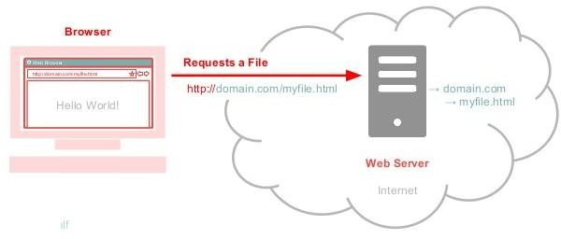


What is a Web Browser?
A web browser (commonly referred to as a browser) is a software application for retrieving, presenting, and traversing information resources on the World Wide Web.

Slide 25
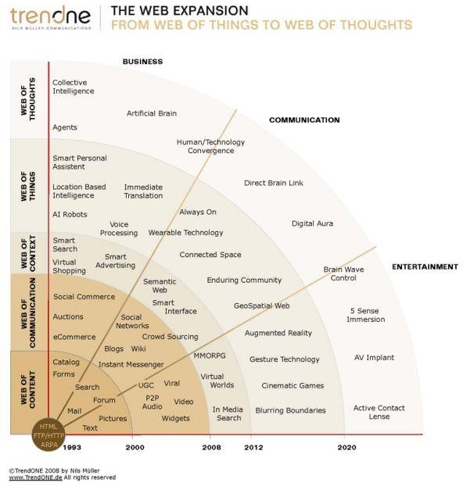
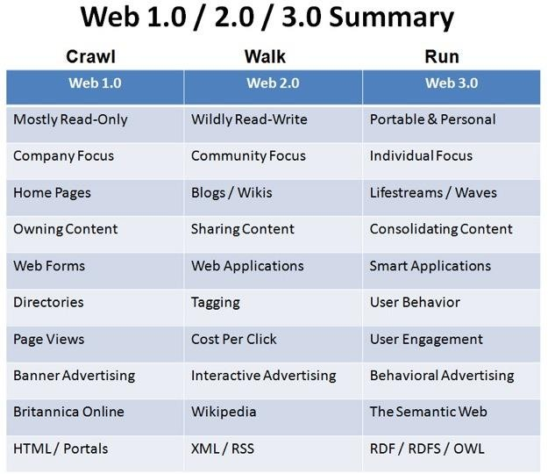
Image source: https://flatworldbusiness.wordpress.com/flat-education/previously/web-1-0-vs-web-2-0-vs-web-3-0-a-bird-eye- on-the-definition/

Slide 26
Web 2.0 (Collaboration)
The second stage of development of the World Wide Web, characterized especially by the change from static Web pages to dynamic or user-generated content and the growth of social media.
Web 3.0 (Context)
This third evolution of the web is identified as the Semantic web which loosely is the mapping of understanding of the relationship of all content and participation.
Image source: https://flatworldbusiness.wordpress.com/flat-education/previously/web-1-0-vs-web-2-0-vs-web-3-0-a-bird-eye- on-the-definition/

Slide 27
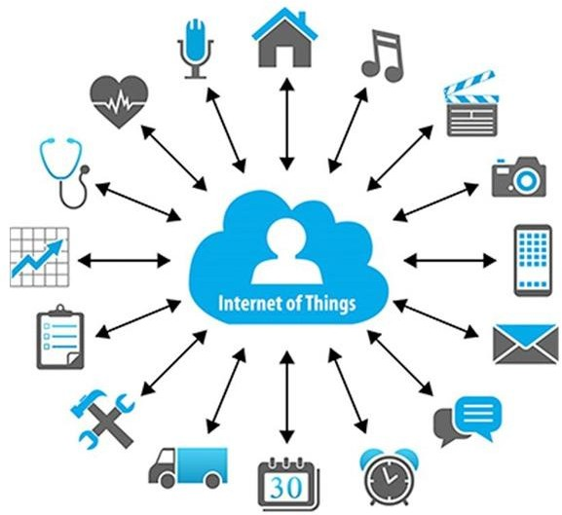
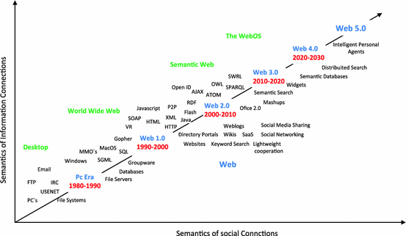
Web 4.0 - Internet of Things (IoT)
This term refers to a network of objects not historically connected.
The evolution of the internet will include everyday objects withy network connectivity able to send and receive data.
Web 5.0 - emotional web
The next big evolution will be about the (emotional) interaction between humans and computers. For the moment web is “emotionally” neutral, which means web does not perceive the users feel and emotions. This will change with web 5.0 – emotional web

Slide 28
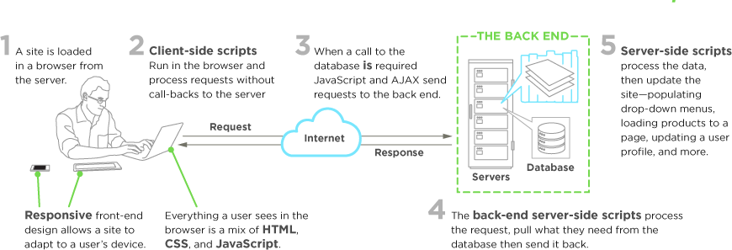
Basic design and implementation of websites
Image source: https://www.upwork.com/hiring/development/front-end-developer/

